Slide 1

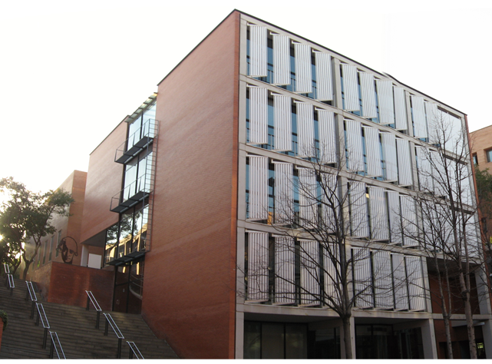


Pre-enrolment ONLINE INFORMATION SESSION:
January 24th, 2025 at 13:00
Google MEET : https://meet.google.com/zyo-nyui-ncm
(you need to access through your UPC student account: name.surname@estudiantat.upc.edu )

Slide 2
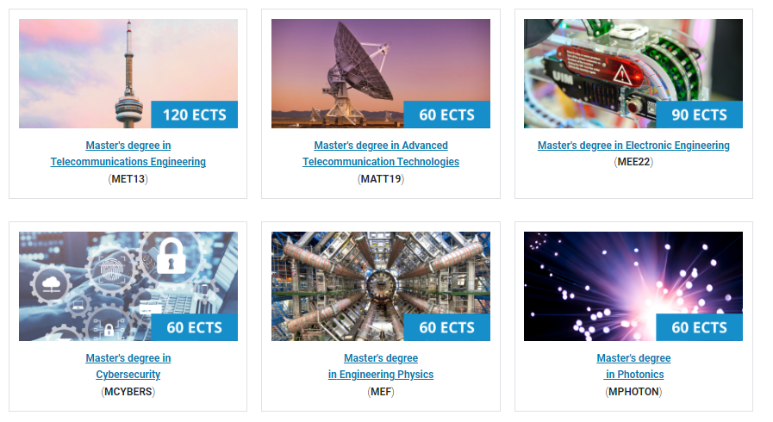

ON-LINE ENROLMENT
1st and 2nd week of February 2025 (to be confirmed)
Check your enrolment date and hour
at the e-Secretaria
http://prisma-nou.upc.edu/estudiants

Slide 3


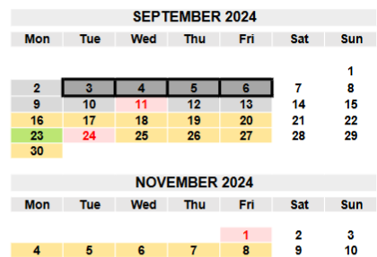
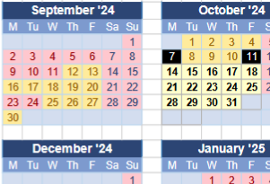
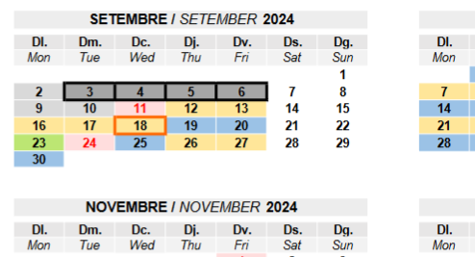
2024-25 Academic year
Beginning of classes:
MEF, BIOPHAM:
February 5th
MET, MATT, MEE,
Cybersecurity and Photonics:
February 12th
Check your exact master’s Academic Calendar here:
https://telecos.upc.edu/ca/curs-actual/calendaris/calendaris-lectius

Slide 4
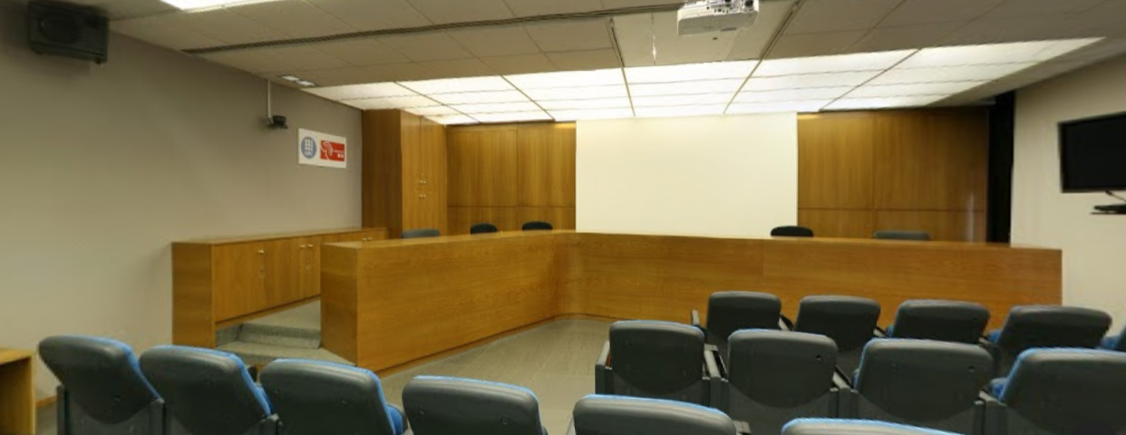
Welcome and ACADEMIC Presentation: MET & MATT
Masters' Welcome and ACADEMIC Presentation:
Bear in mind that the master academic presentation could be some days later than the classes beginning. Please check the classes’ timetables: Current course (link)
Master's degree in Telecommunications Engineering (MET)
&
Master's degree in Advanced Telecomunications Technologies (MATT)
February at 11 am
In person at TELEENSENYAMENT (B3-Building Ricardo Valle Room 103 1st floor)
Google MEET : ON-LINE SESSION : https://meet.google.com/cwd-eeud-itr (you need to access through your UPC student account: name.surname@estudiantat.upc.edu )

Slide 5
Welcome and ACADEMIC Presentation: MEE & MEF
Masters' Welcome and ACADEMIC Presentation:
Bear in mind that the master academic presentation could be some days later than the classes beginning. Please check the classes’ timetables: Current course (link)
Master's degree in Electronic Engineering (MEE)
February at 12 am
In person at TELEENSENYAMENT (B3-Building Ricardo Valle Room 103 1st floor)
Google MEET : ON-LINE SESSION : https://meet.google.com/jzw-gpxt-ncz
(you need to access through your UPC student account: name.surname@estudiantat.upc.edu )
Master's degree in Engineering Physics (MEF)
To be confirmed
In person at Aulari A4-103

Slide 6
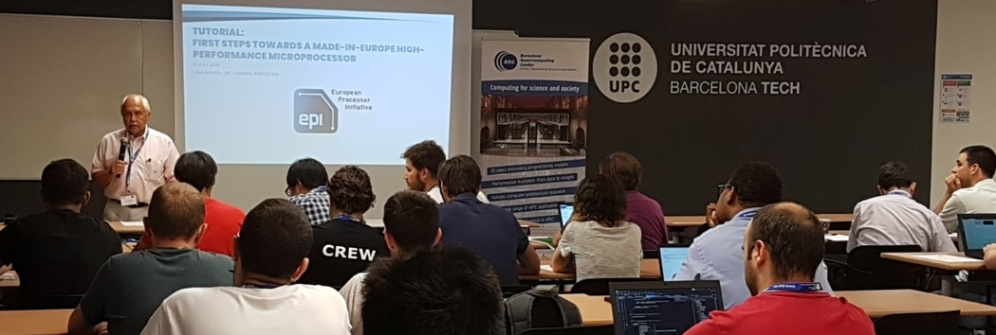

TEACHING METHODOLOGY
The masters teaching methodology is based on face-to-face mode, so we expect you to be here in person the first week of September.
For those students who may have problems being in Barcelona by then, when the lectures begin, due to VISA procedures or other issues, please contact your assigned TUTOR to inform him/her about your expected arrival date, we will do our best to help you.

Slide 7



REQUIRED SUPERVIRSOR FORM (Only MEE and MATT)
IMPORTANT FOR MEE/MATT/PHOTONICS students :
SUPERVISOR FORM signed by your TUTOR :
Master in Electronic Engineering (MEE). Supervisor's form.
Master in Advanced Telecommunications Technologies (MATT). Supervisor's form.
Before enrolment, you must contact your tutor to have this form signed with the courses to enroll.
The name and e-mail address of every student's supervisor is detailed at the Enrolment information document (MASTERS. Enrolment New students)
Once its signed send it to : masters.etsetb@upc.edu

Slide 8
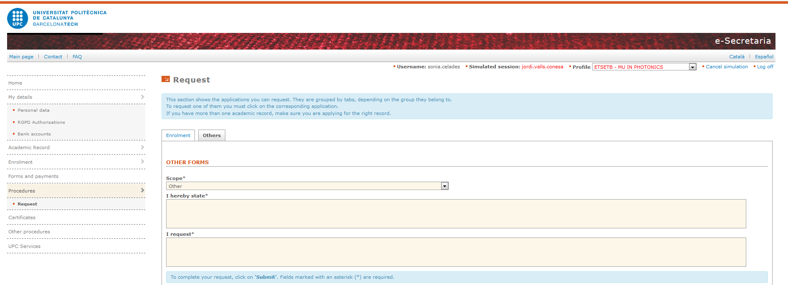
The e-secretaria is the platform where you must request changes in your enrolment, certificates, update your personal data, introduce a Bank account, download your enrolment documents as well as consult the forms and payments.
E-secretaria

Slide 9
Enrolment requirements: Previous steps and documentation
The following are the previous steps the student must follow to be authorized for enrolment:
The student must have accepted the master in our pre-enrolment system
(Deadline January 31th)
The student must have entered e-secretaria correctly.
!!! The first time the student enters e-secretaria, they must fulfill both “Personal data” and “RGPD Authorisations” from the “My details” section, otherwise they will not see any other sections.
The student must have paid the 300€ “Enrolment deposit” fee in e-secretaria.
The student must have uploaded the required academic and personal documentation in e-secretaria under the “Document input” section.
!!! Non-Spanish students must upload a photocopy of their Passport or NIE.
As soon as the student acquires a NIE, they will have to upload a photocopy of it.
The required academic documentation will differ from student to student depending on where the student completed their bachelor’s degree:
Bachelor degree completed at the UPC
Bachelor degree completed at any other public university in Spain
Bachelor degree completed at foreign universities and other higher education institutions

Slide 10
Enrolment requirements: Required academic documentation type A and B
Required academic documentation type A:
Bachelor’s degree completed at the UPC
The student do not need to upload any document.
The student will be authorized only if they have already paid the 218,15 € taxes for the Bachelor’s degree Diploma. The student should check in e-secretaria if their “expedient de Grau” is “CLOSED” and their status is “TITULAT”. If that’s the case the student will be authorized for enrolment automatically.
Títol i suplement europeu
Required academic documentation type B:
Bachelor’s degree completed at any other public university in Spain
The student must upload their bachelor’s degree Diploma and Transcript of records, both documents must be digitally signed and/or with QR/verification code.
Alternatively to these two documents, the student can upload the SET (Suplement Europeu del Títol), also digitally signed and/or with QR/verification code.

Slide 11
Enrolment requirements: Required academic documentation type C
Required academic documentation type C:
Bachelor’s degree completed at foreign universities and higher education institutions
The student must upload their bachelor’s degree Diploma and Transcript of records
Both documents must be digitally signed and/or with QR/verification code.
The documentation must be in Catalan, Spanish or English languages. Otherwise, it must be translated.
The documentation must be legalized whether by diplomatic means or by the corresponding apostille.
For further information regarding translation and legalization of documentation, check the following “Legalisation and translation of documents issued outside Spain” website:
https://www.upc.edu/sga/es/expedientes/LegDoc/legalisation-and-translation-of-documents-issued-outside-spain-1

Slide 12
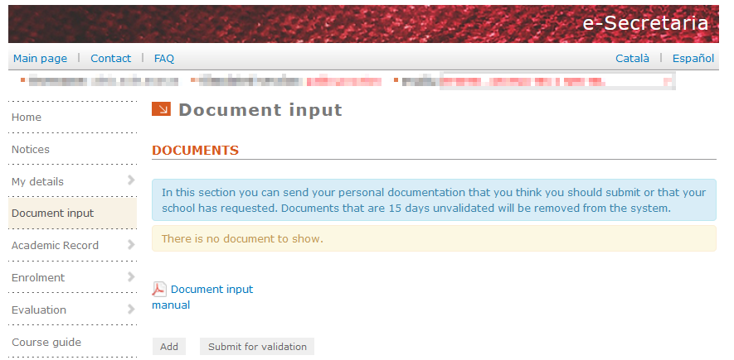
Enrolment requirements: Uploading documentation in e-secretaria
When uploading the documentation in e-secretaria under “Document input” section:
Under type of document “Non-UPC personal academic transcript” : CERTIFIED DIGITAL SIGNED TRANSCRIPT OF RECORDS
Under type of document “Bachelor's degree certificate or substitute document” your BACHELOR’s DIPLOMA or official document that prove you have paid the corresponding fees for the university to issue the diploma
Under type of document: “Diploma supplement” the European Diploma supplement (it's not mandatory if the two previous documents are sent)
Only for foreigners students your ID: - Passport -Foreign Identification number or -NIE evidence
Once you upload a document, make sure to press “Submit for validation” otherwise it will not be able to be reviewed
!!!
Upload the documentation at least 5 days prior enrolment date so there is enough time for verification. If you upload it later there might not be in time for the enrolment date

Slide 13
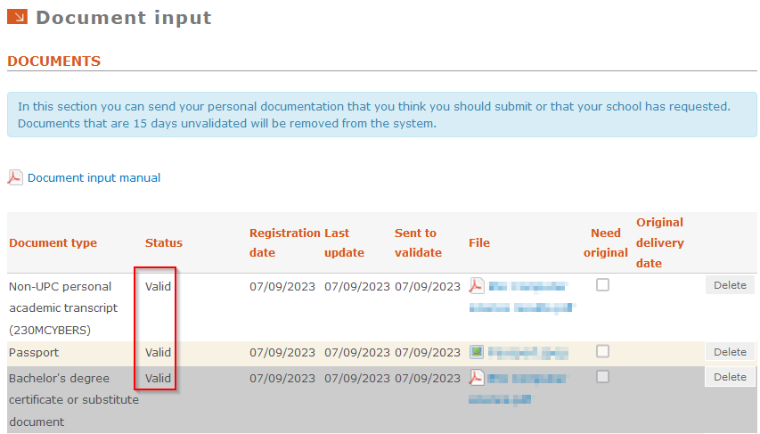
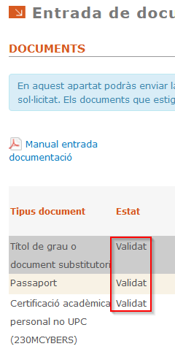
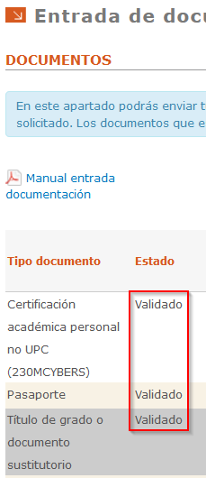
Enrolment requirements: Considerations
Important
We warn you that, even if you see in the e-secretaria an enrolment date does NOT mean that the “SELFENROLMENT” button is authorized for you.
The self enrolment will be activated on February only if you have sent to validate on the e-secretaria the academic documentation and it is in “Valid” state.

Slide 14
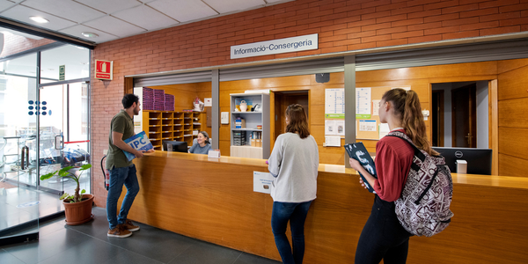
Enrolment requirements: Considerations
Exceptionally, and only if your University, don’t provide you documents digitally signed and/or with QR/verification code you must present ORIGINAL or AUTHENTICATED COPY of the required documents as soon as you reach Barcelona and no later than October 30th in our secretary office.
Otherwise your enrolment will be cancelled and you will lose all the rights to this master as well as all the fees paid.
Prior appointment is required to FACE-TO-FACE attention:
Please check how to reach us to hand us this documents in this link: PRIOR APPOINTMENT

Slide 15
Enrolment information
If I am admitted, will I be able to enroll in the master's degree, even if I have still pending to pass the Bachelor Thesis(TFG )to be graduated?
Only those students that can officially prove that they have paid the Bachelor Title fees will be allowed to enroll.
But only for UPC BACHELOR students:
The modification of the ETSETB masters ‘regulation (*) establishes that it will only be allowed to enroll the Bachelor’s UPC students (on the days established for each semester without the need for a place reservation) if the only remaining ECTS to pass are exclusively those of the bachelor thesis (TFG) and only if the student can prove that the BACHELOR Thesis is correctly enrolled. All the other ECTS have to appear officially passed in your academic transcript in order to be allowed to enroll.
(*) the Point 1.2. Access to the master's degree studies of the NAGRAMA establishes that “The center responsible for the degree may define additional conditions on the credits pending, or not allow access”
In view of the special circumstances, the necessary means will be enabled so that the late readings can begin the master's degree only if it’s approved by the master TUTOR and master coordinator by requesting and paying the Place Reservation fees in the event of the day of registration they are not yet graduated.
Students that present their bachelor final thesis after enrolment date :
These students must contact their tutor to inform of this situation and determine the subjects they will follow.
Request SEU-ELECTRONICA a “Reserva de Plaça /Place Reservation” until they enroll, otherwise their place will be given to those candidates in the waiting list.
(https://seuelectronica.upc.edu/ca/Tramits/Instancia_Director_Directora_Dega_Degana_Academics )
Will be allowed to enroll later (loosing the ranking enrolment order: with no right to reserve places in any specific subject or groups) but October 31 the latest!
They must proved with the DIGITALLY SIGNED certificate that they have paid the fees for the issuing of the Bachelor’s diploma. Otherwise they won’t be able to enroll.

Slide 16

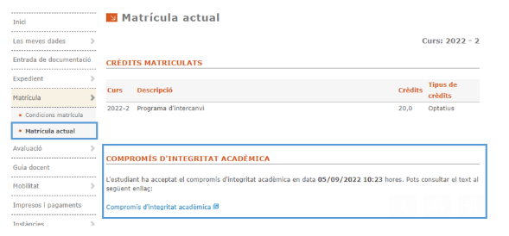
REQUIRED E-SECRETARIA signature
Before enrolment, you must sing the mandatory commitment to academic integrity
If you are going to pay by direct debit or in instalments, you need to have a bank account of one of the SEPA countries at least one week prior the enrolment to have time to be approved.
NEW: Add or modify a Bank Account.
(see page 19 of this guide)

Slide 17

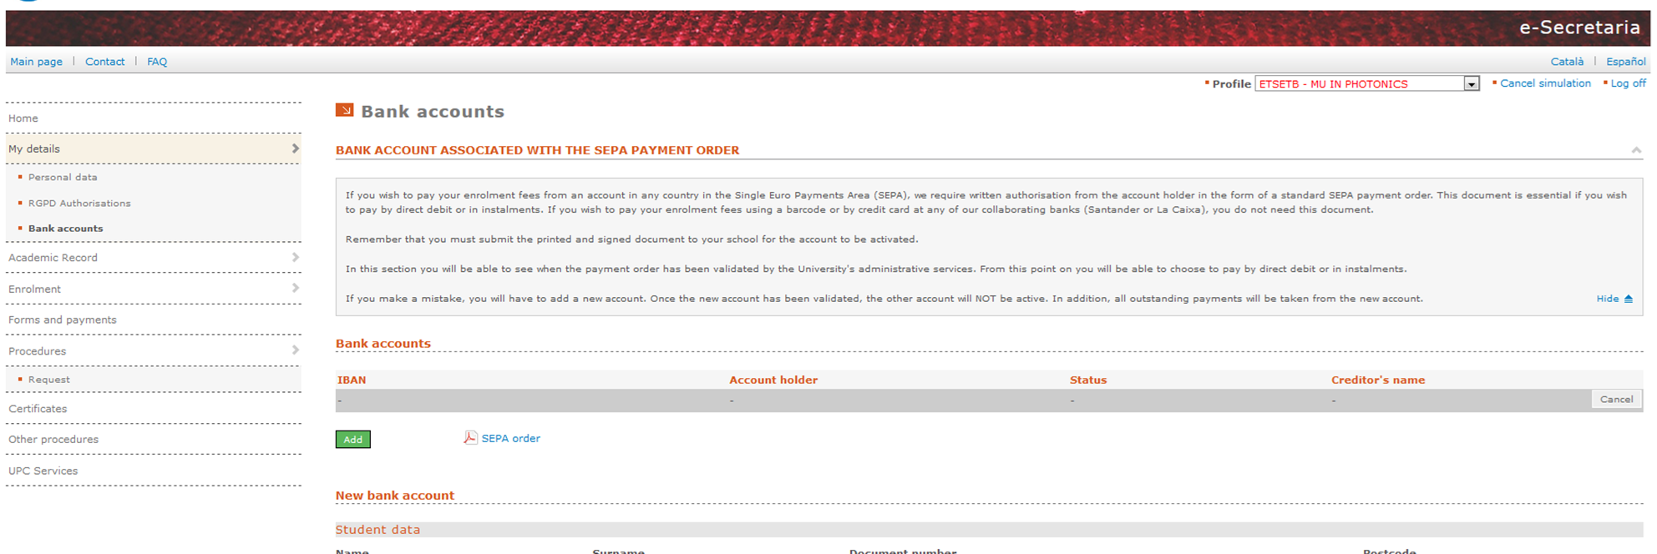
e-secretaria: Payments
If you are going to pay by direct debit or in instalments, you need to have a bank account of one of the SEPA countries.
NEW: Add or modify a Bank Account.
You won't need this document if you are going to pay in one only payment (by Visa or Mastercard through e-Secretaria or cash at one of the bank entities that will appear at the enrollment form).

Slide 18

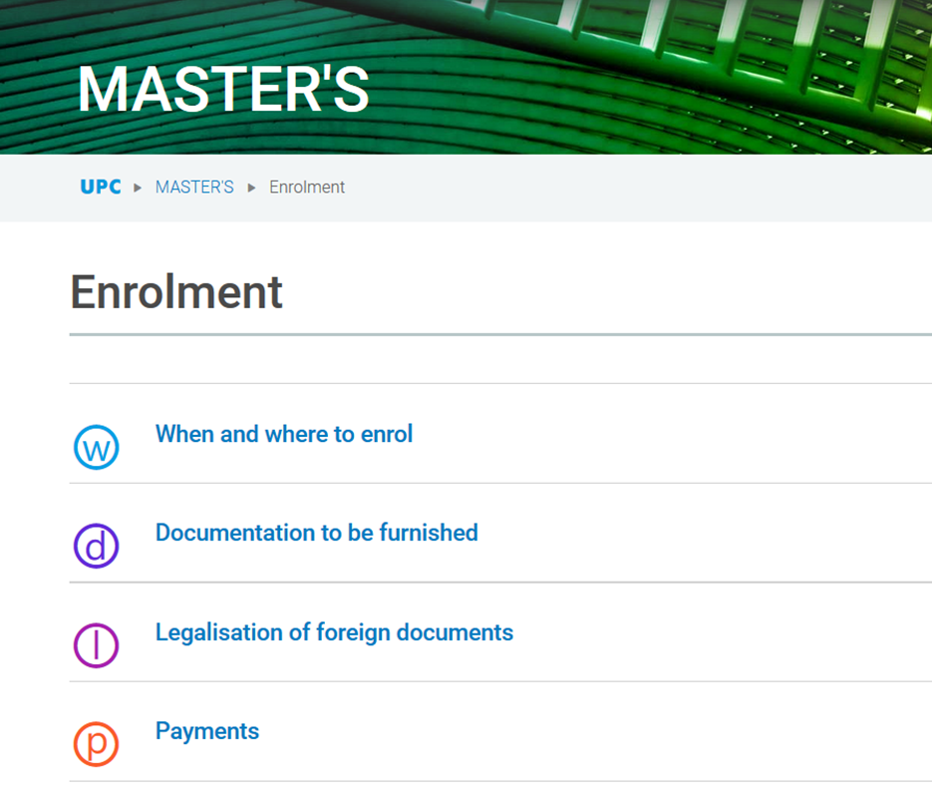
PAYMENT OPTIONS
MASTERS. Enrolment New students
Payment options
Consult the option for paying in two or three instalments offered by the UPC.
The instalment options are as follows:
For semesterly enrolment (MEE/MET/MATT/MEF/CYBERS), 60% of the enrolment fees are paid when you enroll and the remaining 40% are paid in mid-December (enrolment in the first semester) or early April (enrolment in the second semester).
For annual enrolment (PHOTONIC) , 40% of the enrolment fees are paid when you enroll, 30% in mid-December and 30% on 1 March.
You need to add a Bank Account in the e-secretaria NEW: Add or modify a Bank Account.

Slide 19
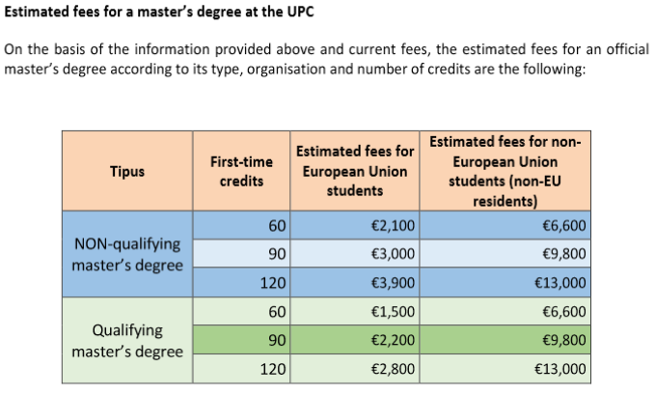
Fees, grants and payment options
Who sets the fees
The fees for official master's degrees are regulated in Article 81.3.b of Organic Law 6/2001, of 21 December, on Universities, in the wording of Royal Decree-Law 14/2012, of 20 April. In the case of studies leading to official degrees that are valid throughout Spain the public fees are set by the Government of Catalonia, within the limits established by the General University Policy Conference. The fees are not approved until the beginning of July, before the start of the academic year, so the total amount to be paid cannot be determined exactly until the moment the student enrolls.
The fees for official master's degrees are regulated in Article 81.3.b of Organic Law 6/2001, of 21 December, on Universities, in the wording of Royal Decree-Law 14/2012, of 20 April. In the case of studies leading to official degrees that are valid throughout Spain the public fees are set by the Government of Catalonia, within the limits established by the General University Policy Conference.The fees are not approved until the beginning of July, before the start of the academic year, so the total amount to be paid cannot be determined exactly until the moment the student enrols.
Cost per credit and surcharge for repeat enrolment
If you need to re-enroll the credits that you have not passed, there is a surcharge when you enroll for the second, third or fourth time.
Verification of prices
Check SGA’s (UPC’s general services) website to verify the fees and prices:
https://www.upc.edu/sga/ca/matricula/preus/estimacion-precios-documentos/curs-2024-2025/2024-2025-fees-por-official-masters-degrees_copia_autentica.pdf/view

Slide 20
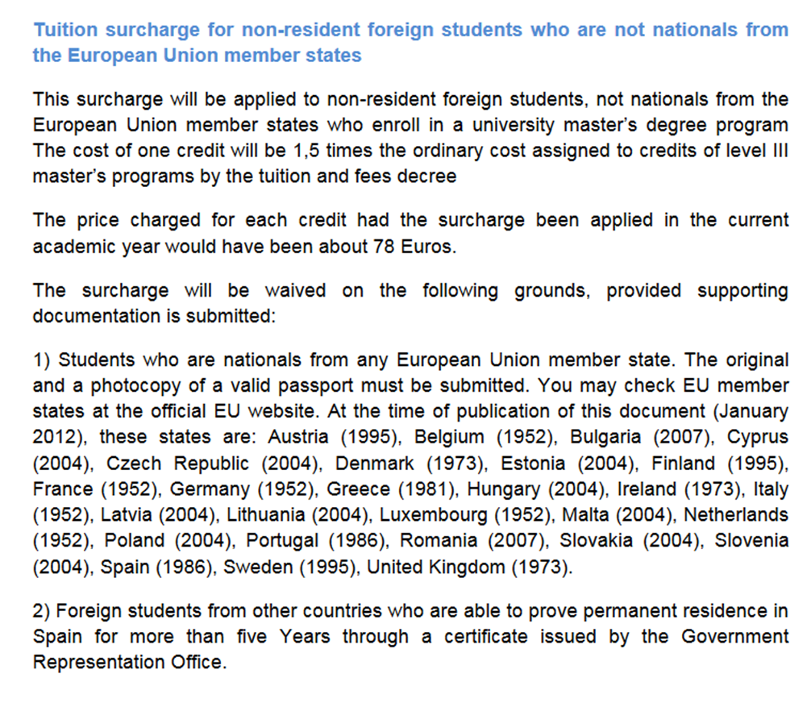
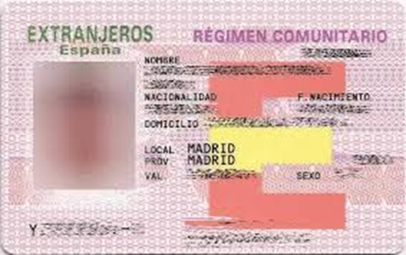
NON-RESIDENT FOREIGN STUDENTS WHO ARE NOT NATIONALS OF EU
The cost per credit for non-resident foreign students who are not nationals of EU member countries is 1.5 times the standard credit cost
Fees for foreign students aged over 18 who are not residents and are not EU nationals or covered by the European community regime may reach 100% of the real cost of university master's degree teaching, without prejudice to the principle of reciprocity. More information (Spanish)
Once you have the NIE you must bring us a photocopy:
Although as required by the normative we introduce your NIE in the system, it does not change your nationality consequently the application of the surcharge is for all your stay.
https://www.upc.edu/sga/ca/shared/fitxers-matricula/tuition-and-fees-for-master.pdf

Slide 21
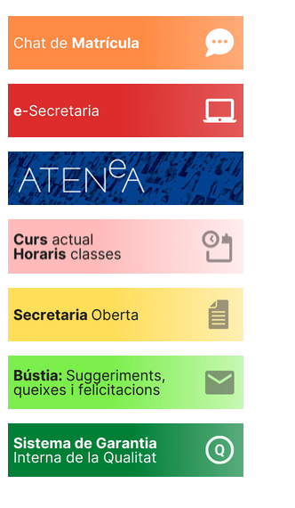
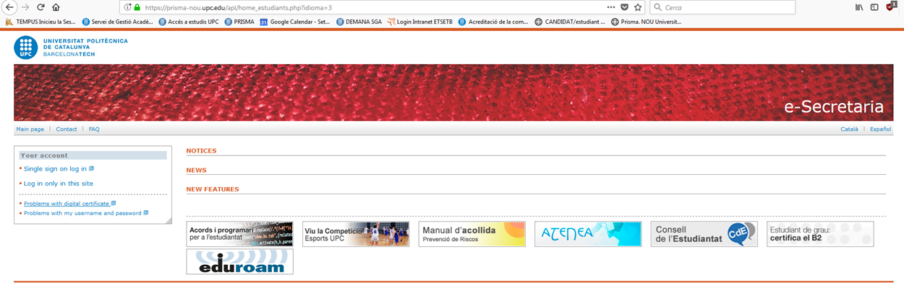
Username and password and ICT services
When you accepted the admission to the master, you were assigned a username and password to do the payment in advance of enrollment (300 euros).
This username and password gives you access to:
The electronic secretary e-Secretaria
The Virtual Campus Atenea. (24 hours after the enrolment)
The ICT services of ETSETB (Intranet, webmail, etc).
If you don't remember your credentials, you can recover them at: https://identitatdigital.upc.edu/gcredencials/recupera-contrasenya

Slide 22
Academic regulations
UPC general regulations
ETSETB / ETSETB Academic regulations
General regulations for masters MET and MEE
Master thesis regulations (English version)
Annexes to ETSETB Academic Regulations for MET and MEE
ETSETB regulations for completion of exams
The ETSETB protocol for action in cases of fraud commited in exams

Slide 23

Academic information - Curriculum
Curriculum/ Subjects
Master's degree in Telecommunications Engineering (MET13)
https://telecos.upc.edu/ca/estudis/masters/masters-degree-in-telecommunications-engineering-met/#tab-curriculum
Master's degree in Electronic Engineering (MEE22)
https://telecos.upc.edu/ca/estudis/masters/masters-degree-in-electronic-engineering-mee/#tab-curriculum
Master in Advanced Telecommunication Technologies (MATT19)
https://telecos.upc.edu/ca/estudis/masters/masters-degree-in-advanced-telecommunication-technologies-matt/#tab-curriculum
Master's degree Engineering Physics (MEF) https://telecos.upc.edu/ca/estudis/masters/masters-degree-in-engineering-physics/#tab-curriculum

Slide 24
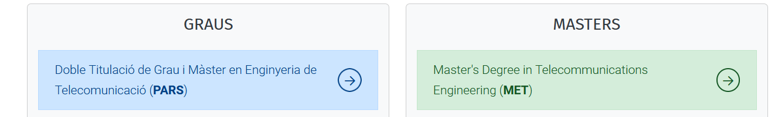
Academic information – Timetables and calendars
Timetables, exams and regulations:
Classes timetables, exams schedule and regulations are available Current course.
Calendars:
Check classes calendars, exam calendars, and enrolment and procedures calendars here:

Slide 25
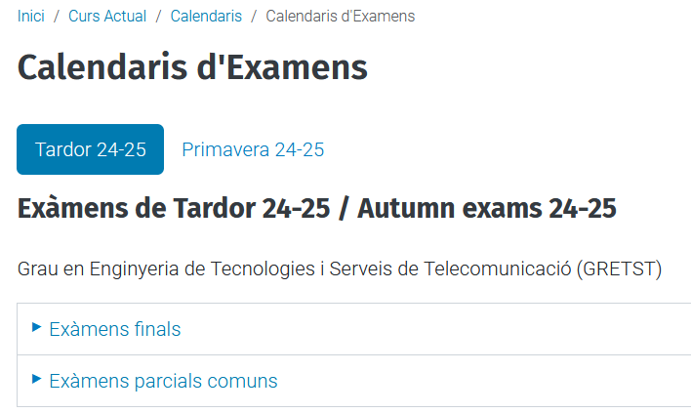
Academic information - Examination
Examination period
https://telecos.upc.edu/ca/curs-actual/calendaris/calendaris-dexamens/calendari-dexamens
Once in the webpage shown in the picture, click where you see your master to see the examination period pdf for the “Autumn semester” (Primavera 24-25)

Slide 26
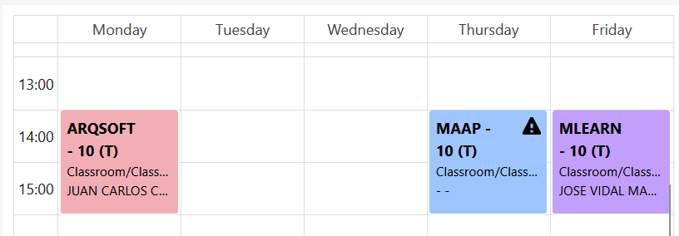
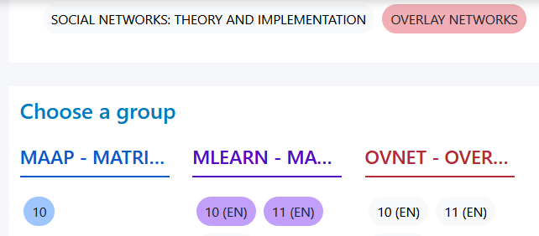
Academic information - Timetables
Planificador d'horaris Timetable Planner
The timetable tool will help you to plan your classes timetable.
!!! MATT Students – Additional comments
“5G Networks” and “Internet of Things” tracks are taught in EETAC (Castelldefels). The rest of tracks are held in our school, the ETSETB (Barcelona).
Keep in mind that, when selecting groups, group number 90 belongs to the EETAC, not ETSETB.
Also, these two tracks subjects might no show up in the timetable planner. Check their timetables here

Slide 27
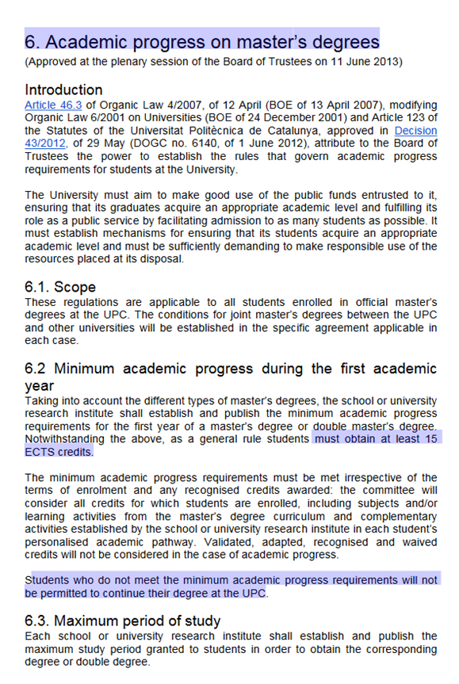
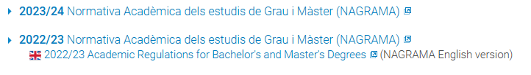
Academic information
Important: Please be very careful while choosing your subjects, since you may be seriously affected later on:
Reimbursement of fees: The following reasons do NOT justify the reimbursement of fees, and if they are not paid, payment will be claimed:
Mistakes made by the student in their enrolment do NOT justify reimbursement of fees.
Changes in working hours or starting a new job do NOT justify reimbursement of fees.
Academic progress: If your performance is poor and you do not pass 15 ECTS the first year you may be expelled (see rules and regulations next page)
NIE renewal : If you do not pass all the enrolled subjects each semester, the police may not renew your NIE when it expires and you will not be able to stay.

Slide 28
Changes in your Enrolment
Changes in your enrolment (without additional fees) Deadlines:
Please check the Deadlines, documents needed and procedure and the steps to follow in the following:
Calendaris de Matrícula i Tràmits acadèmics / Enrolment and Academic Procedures Calendars
Procedure
Except for MET and MEF students, you will need a document signed by your supervisor again and send it to masters.etsetb@upc.edu .
After having sent that document, you will have to do the request by esecretaria.upc.edu (procedures > related to enrollment > enrollment change).
Only one change. You are allowed to do only one change request (unless a course ceases to be taught).
Additional fees. Changes after the deadline
If you do the change after the deadline fixed for enrolment changes, you must pay an additional fee
(around 30 €).

Slide 29
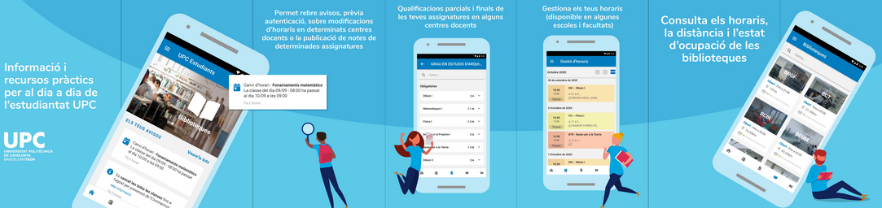
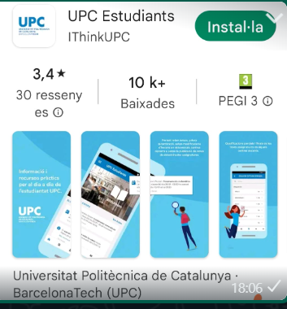
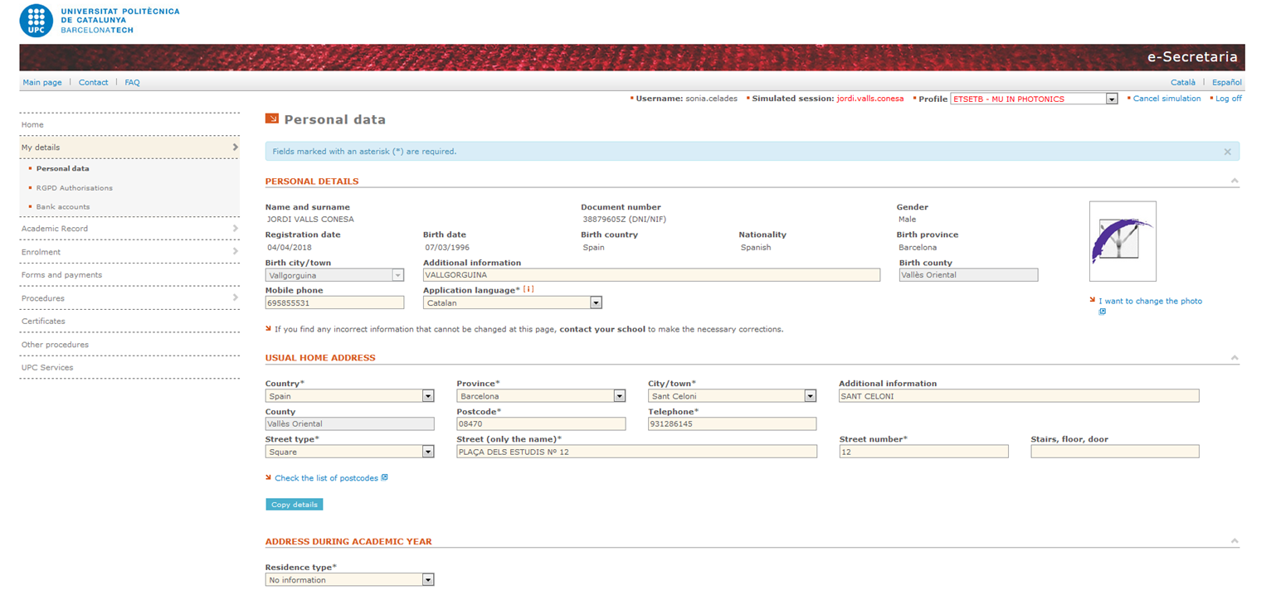
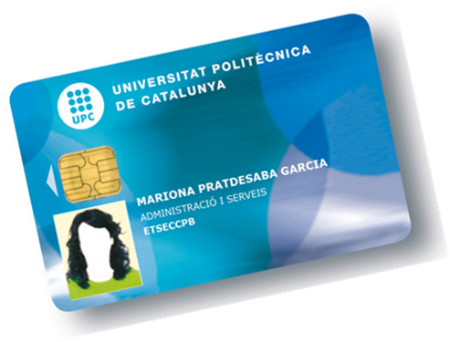
New UPC ESTUDIANTS app
No more plastic UPC card will be issued from now on: you should download a new UPC ESTUDIANTS app
More information on :
https://www.upc.edu/identitatdigital/ca/carnetupc
Upload a PHOTO under PERSONAL DATA section MY DETAILS (E-SECRETARIA)
Provisionally a copy of the enrolment form is valid as a provisional student card if you need it in the library

Slide 30
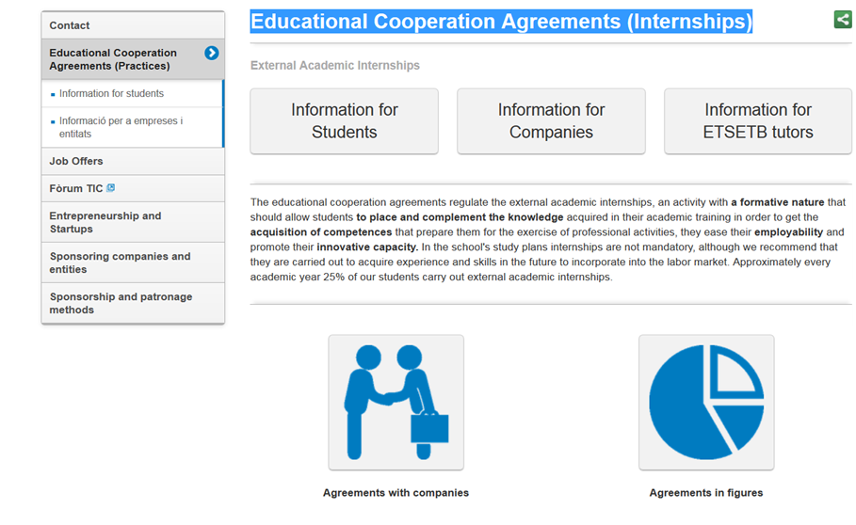
Educational Cooperation Agreements (Internships)
Student attention:
Rosa Frías Building B3 Floor 1
Phone: 93 401 68 36

Slide 31

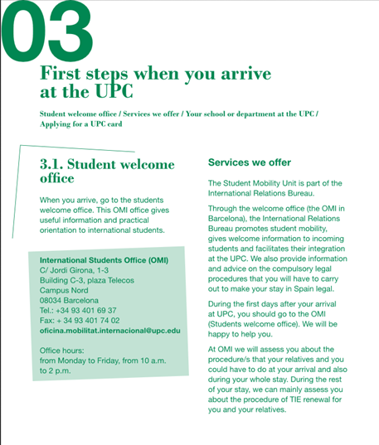
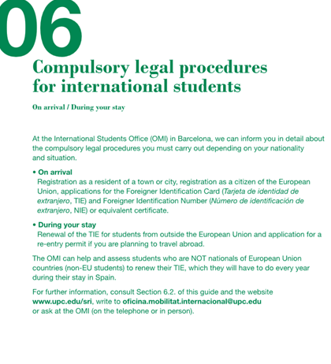
UPC WELCOME GUIDE/OMI
Take a look at these websites to get an idea of how to prepare your UPC stay:
https://www.upc.edu/en/the-upc/institutional-publications/guiaacollida_upc_eng.pdf
For any question or doubt, please do not hesitate to contact International Students Office (OMI)

Slide 32

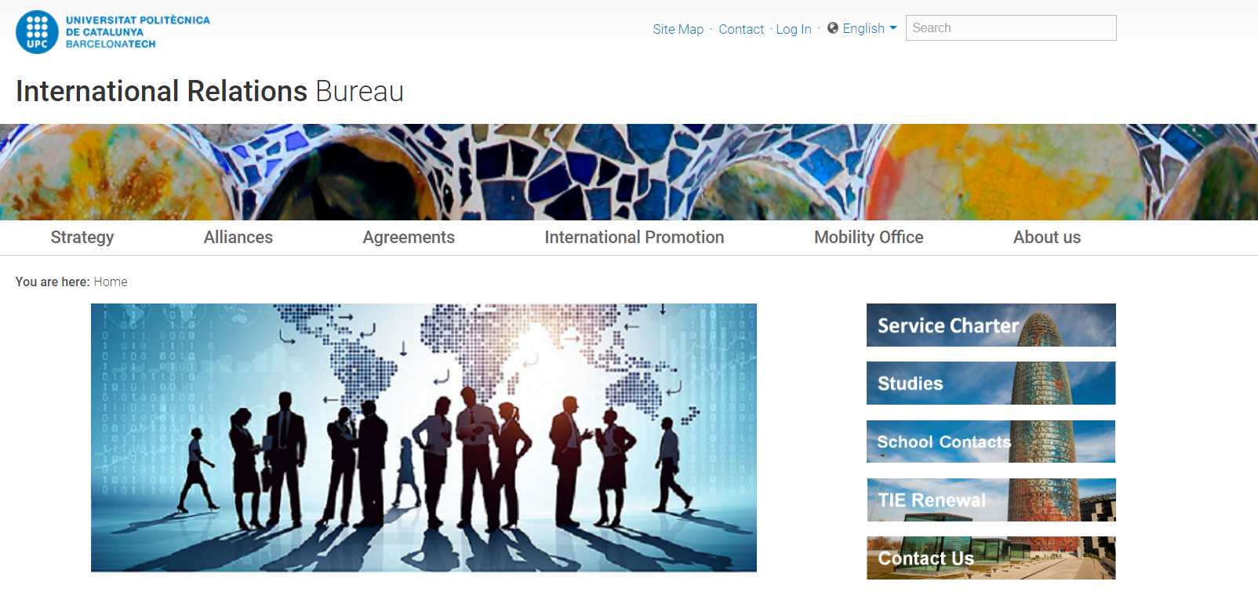
Orientation Week for UPC "International students" . Do not miss it!
The OMI Office will send you an e-mail to inform you how to register to the Orientation Week
Pls

Slide 33
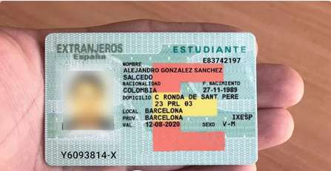

POLICE requirements TIE card
For the TIE , two documents from the university are required to hand to the POLICE once you have an appointment :
Both documents available from your E-SECRETARIA, please request them from e-secretaria :
A registration certificate (download the PDF yourself from your E-SECRETARIA: “Forms and payments” > view form)
Request a “Certificates” > “Apply for a certificate” > “certificate type: others” > “Official academic Transcript for the obtainment of the NIE” digitally signed

Slide 34
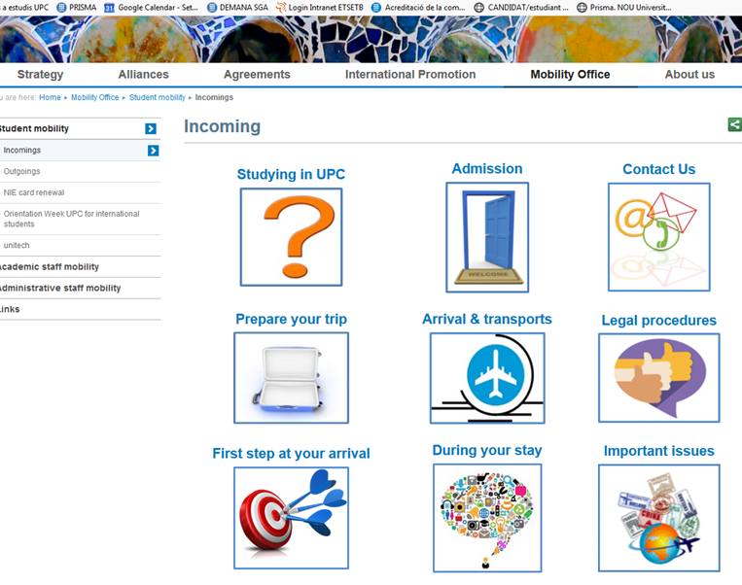
OMI-International Students Office
International Students Office
https://www.upc.edu/sri/en/bureau/where-we-are
c. Jordi Girona, 1-3 Edifici C-3,
Telecos Square CAMPUS NORD Tel: +34 93 401 69 37 Fax: +34 93 401 74 02
E-mail: oficina.mobilitat.internacional@upc.edu
Office hours ( please check their site for the COVID restrictions)
Mornings: From Monday to Friday,
from 10:30 a.m. to 1 p.m. Afternoons: Tuesday afternoon
from 3 p.m. to 5 p.m.
Map
For any question or doubt, please do not hesitate to contact International Students Office (OMI)

Slide 35

Please contact us : 93-4016750 masters.etsetb@upc.edu

